Slide 1

Pass the SALT 2024
7th edition
Welcome !

Slide 2

English Speaking
Please look at the badge
and
switch to EN if you see a globe
(non FR speaking person)

Slide 3
Code of Conduct
Be excellent to each other.
Take care of what you share.
Come to us (red t-shirts) in case of any problem.
🫶 ✊
https://2024.pass-the-salt.org/code-of-conduct/

Slide 4
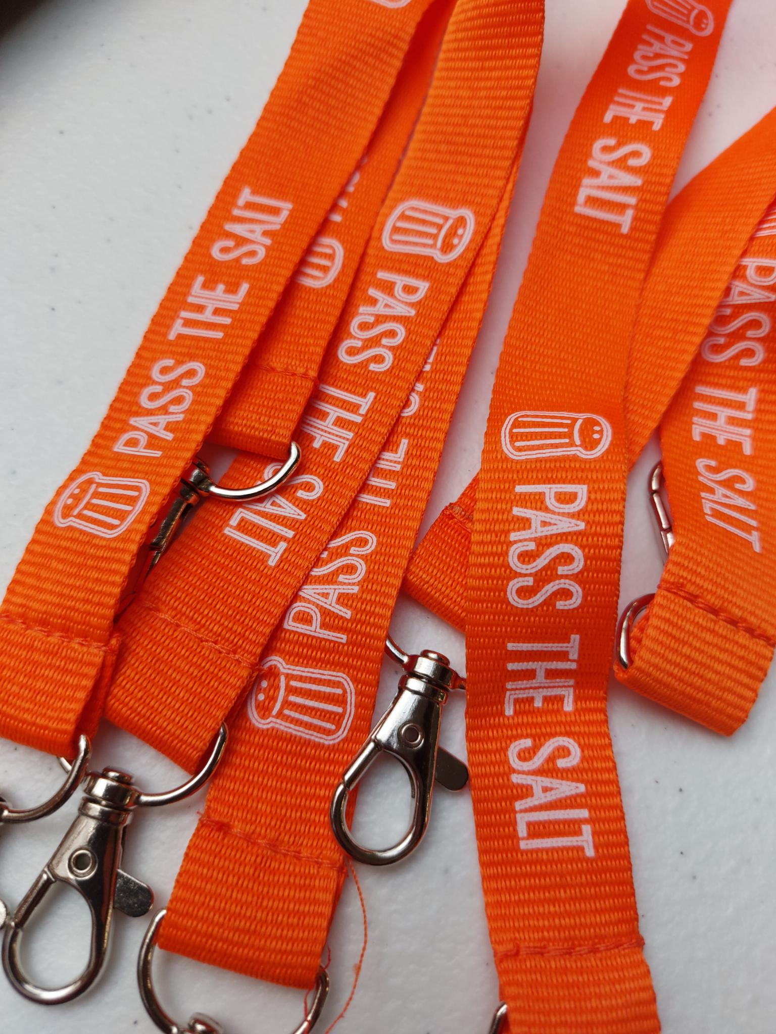
Privacy
If you don’t want to appear on photo,
grab this lanyard at the desk
👈 📵
Everyone: don't take/share pics
if these participants appear!

Slide 5
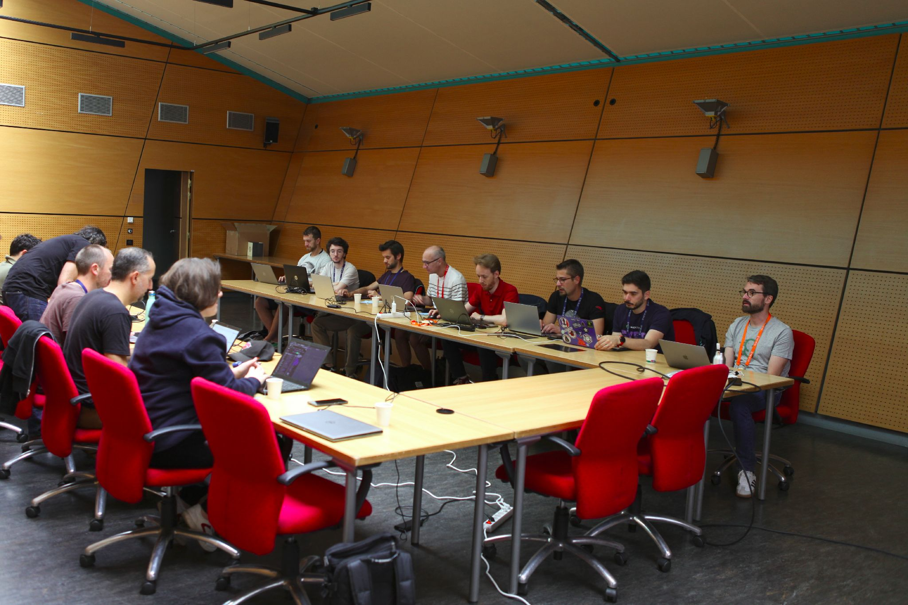
Workshops
To register: use the paper form and pen at the desk table
⚠️ Be there 5min before workshop’s start or you may lose your seat!

Slide 6

Rumps Session
Lightning talks (3-5 min)
Thursday July, 4 - 17:00 → 18:00
Topic: Free software + Security
→ rumps@pass-the-salt.org

Slide 7

Rumps Session
I have nothing interesting to say :(

Slide 8

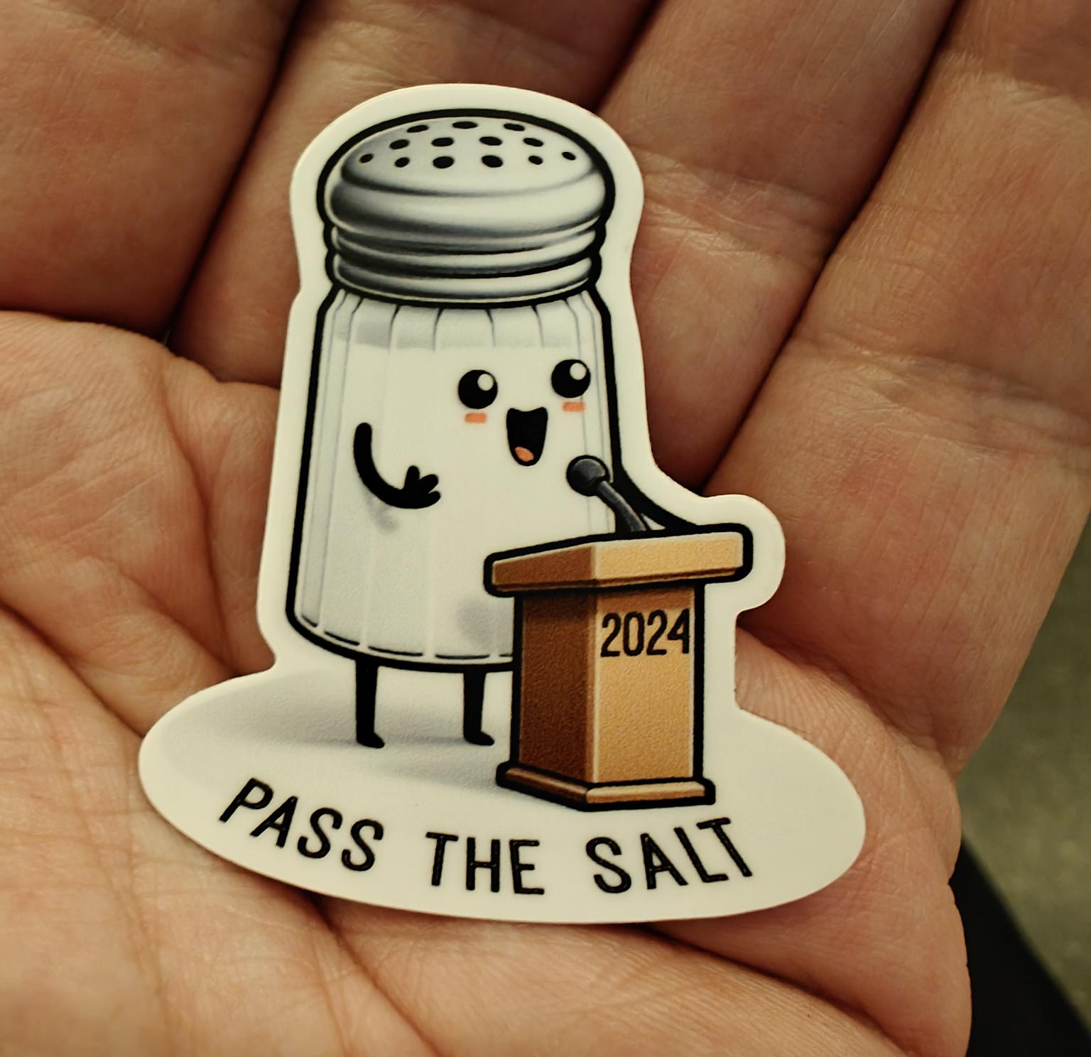
Rumps Session
I submit
& I get this collector sticker :-)
→rumps@pass-the-salt.org

Slide 9

Sponsors
Thanks to
all of them 🙏
Nothing would be possible without their support!

Slide 10

Partners
Thanks to
all of them 🙏
Nothing would be possible without their support, too!

Slide 11
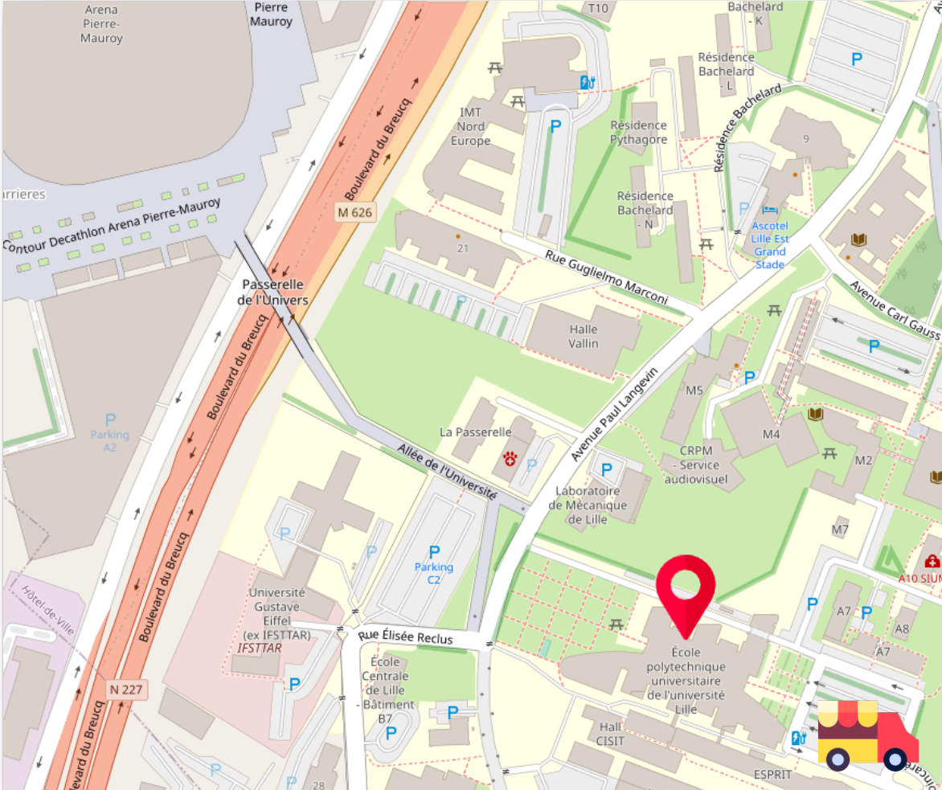
Lunch
1 food truck
on the car park

Slide 12
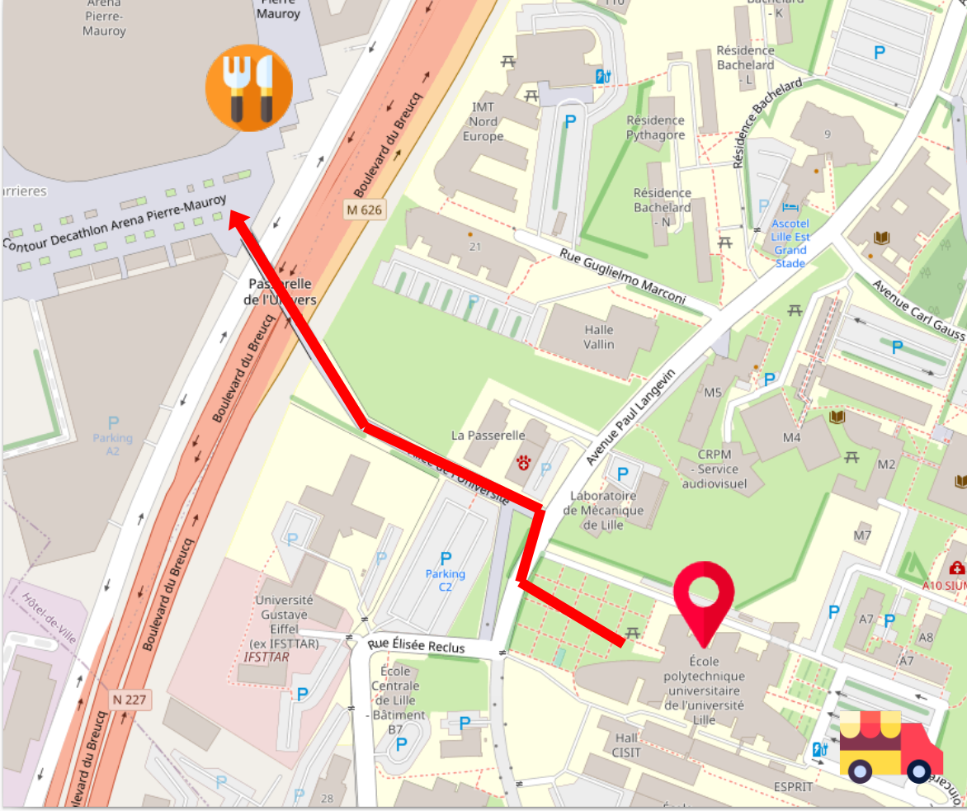
Lunch
1 food truck
on the car park
Restaurants
and food stands
at a 5-min walk near
Pierre-Maurois Stadium

Slide 13
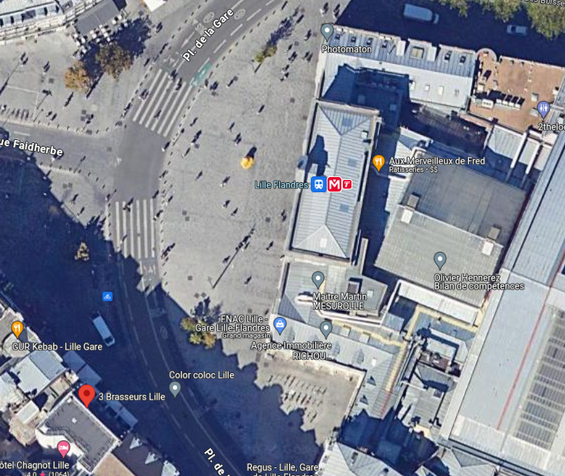
Social event
→ « 3 brasseurs » bar
near Flandres station
→ Thursday evening
19h30 (7:30 PM)

Slide 14
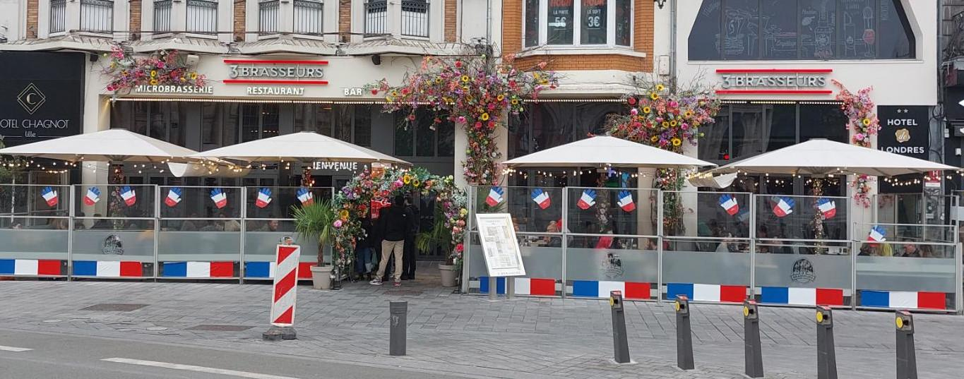
Social event
→ « 3 brasseurs » bar
near Flandres station
→ Thursday evening
19h30 (7:30 PM)

Slide 15
Social event
. Come with your badge to enter

Slide 16

Social event
. Come with your badge to enter
. Come with your 2 coins
→ 2 free drinks

Slide 17

Social event
. Come with your badge to enter
. Come with your 2 coins
→ 2 free drinks
. NEW: we will give coins for free food at each table
during the party

Slide 18
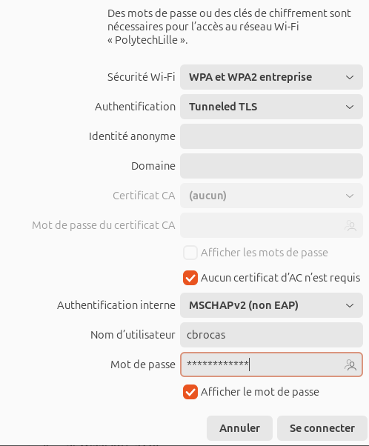
Wi-Fi
EAP Method: PEAP
Authentication : MSCHAPv2
CA Certificate: none
Identity : your username
Anonymous identity: nothing
Pasword: your password
Normally, access to
443 and 22 ports

Slide 19

DEAR SPEAKERS
Welcome 🙏 🥰
Now, the scene is YOURS
for 2.5 days 🚀

Slide 20
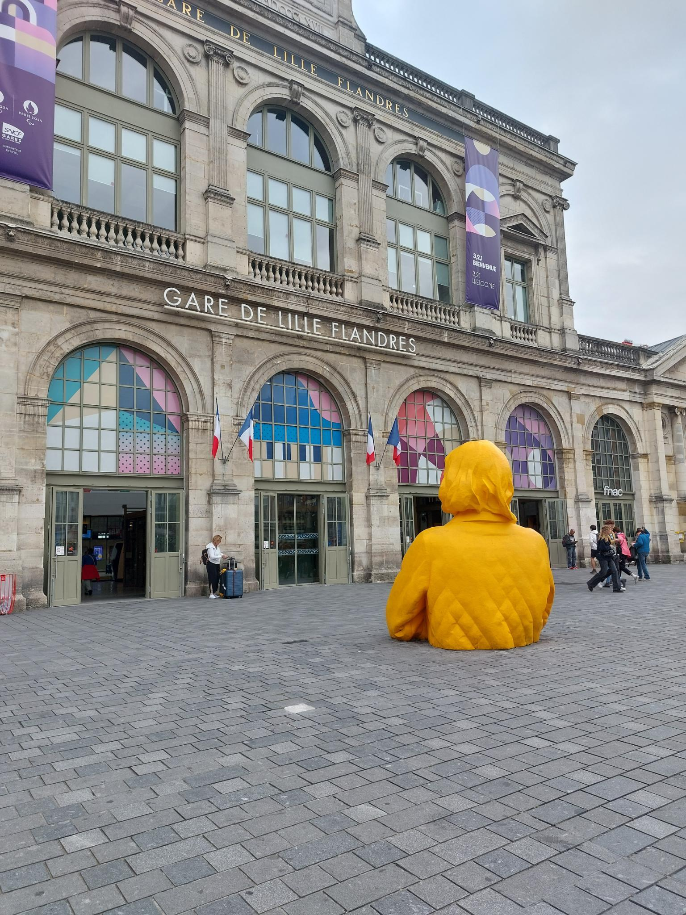
SPEAKERS DINNER
← Meeting point to go in group to the restaurant : 19:30 / 07:30PM
in front of Lille Flandres Station
Restaurant Las Tapas
116 Rue Saint-André,
59000 Lille

